Slide 1
FRB Update #33
William Huang
(09/05/2021)

Slide 2
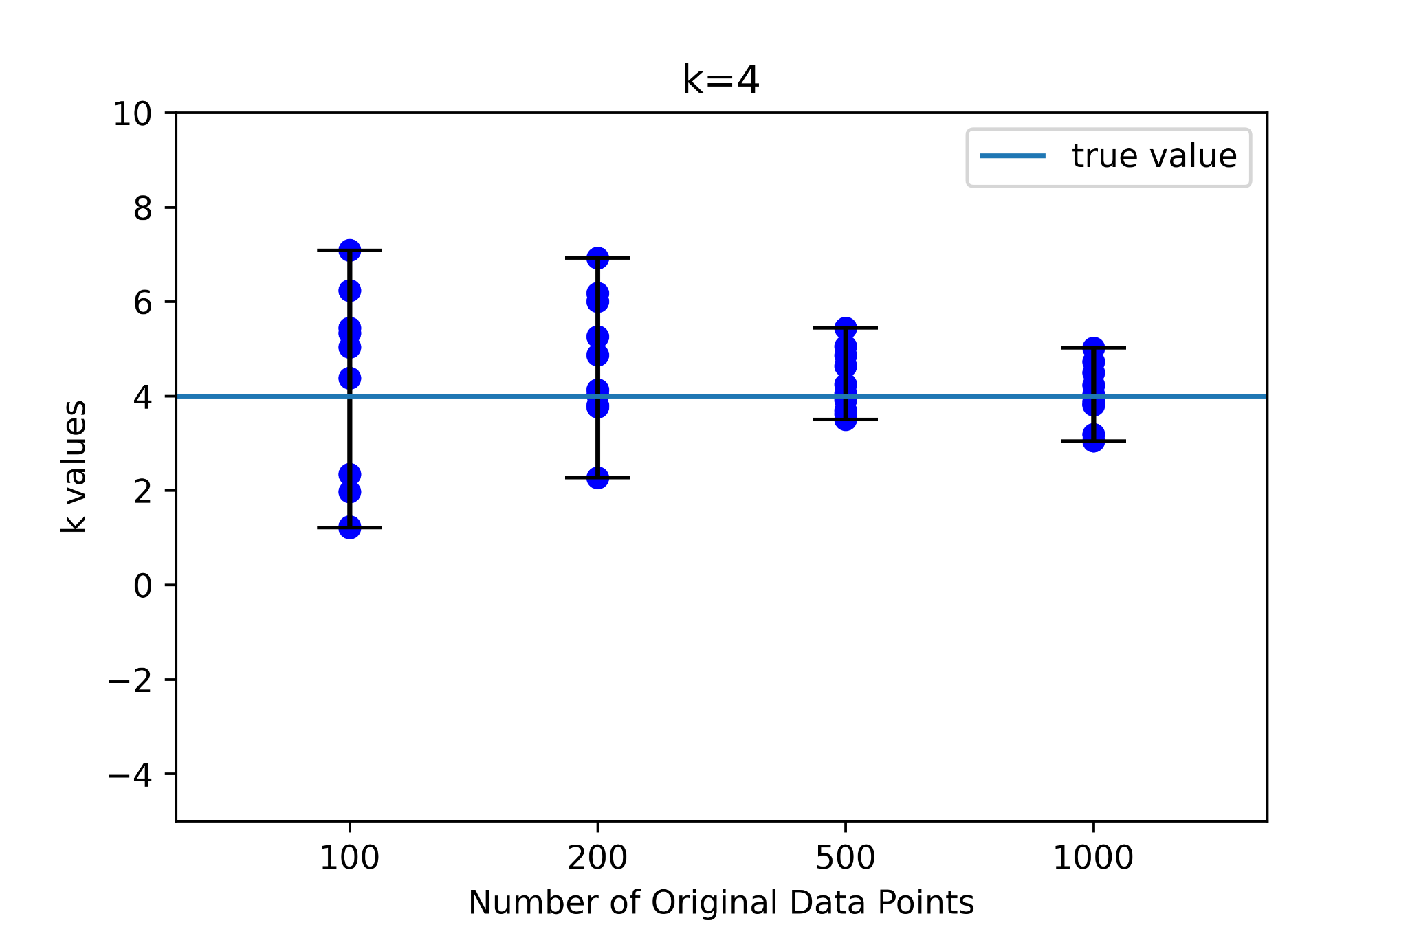
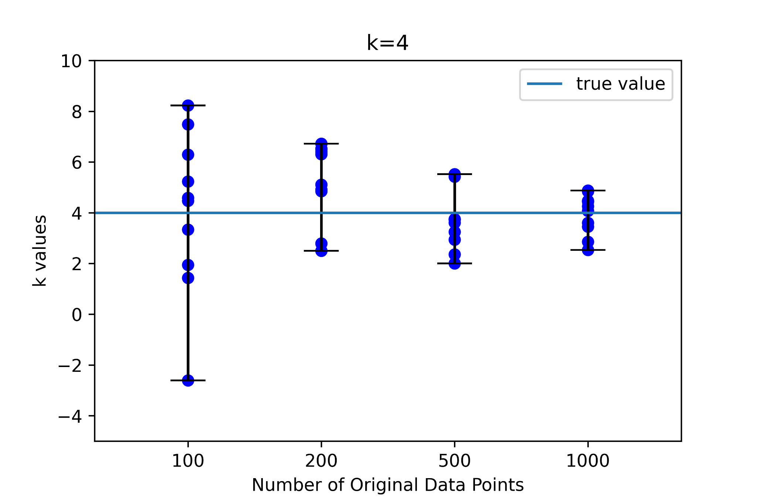
New power law E distribution
Note that the previous E distribution used was random in log space, meaning each energy was 10^{n}, where n has a random distribution and 23 < n < 26. It is not a pure random law, where it would be equally likely to have any number 10²³ to 10²⁶.
The new power law distribution had a distribution with exponent -1.2. Compared to the previous E distribution, the power law in general makes the variance in k slightly larger.
Old E distribution
Power law distribution

Slide 3
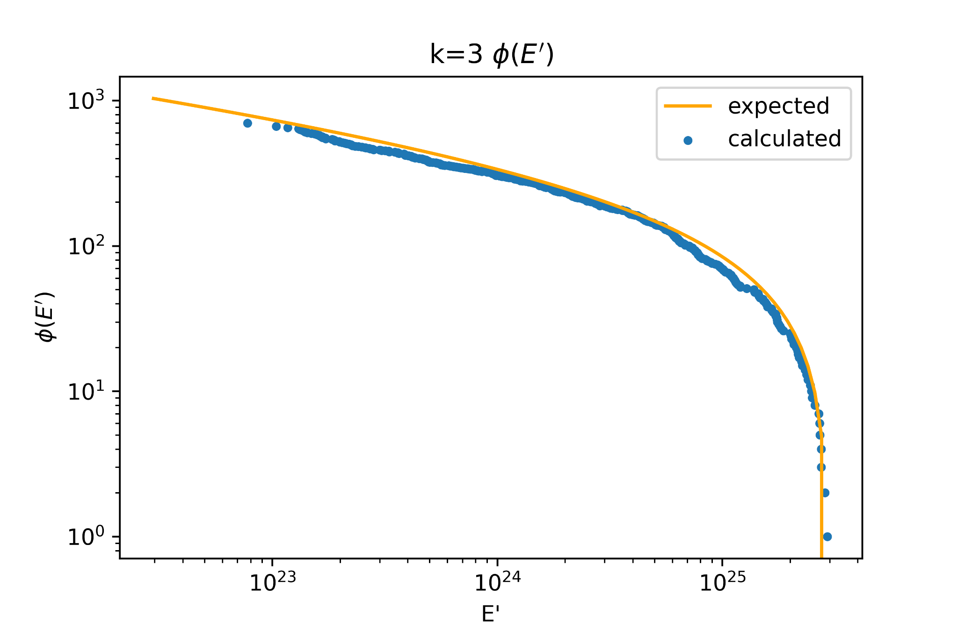
Determination of E Distribution through Phi
An example Phi(E’) distribution is plotted on the right, along with the expected distribution. Note that even though it is a power law distribution, the expected distribution is not a straight line: the power law is only from around 10^{22.5} to around 10^{25.5}, and the sharp cutoff causes the expected distribution to be proportional to
E^{-0.2} - (10^{25.5})^{-0.2}
With this in mind, Phi(E’) matches the true distribution in energy.

Slide 4
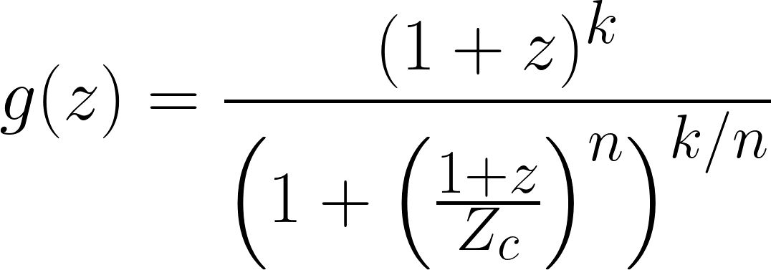
New g(z) function
Previously, g(z) = (1+z)^{k}. This caused some non-monotonic truncations. We use a new function which has the following form:
In subsequent graphs, we use the tentative values of Z_{c} = 3.5 and n = 3.

Slide 5
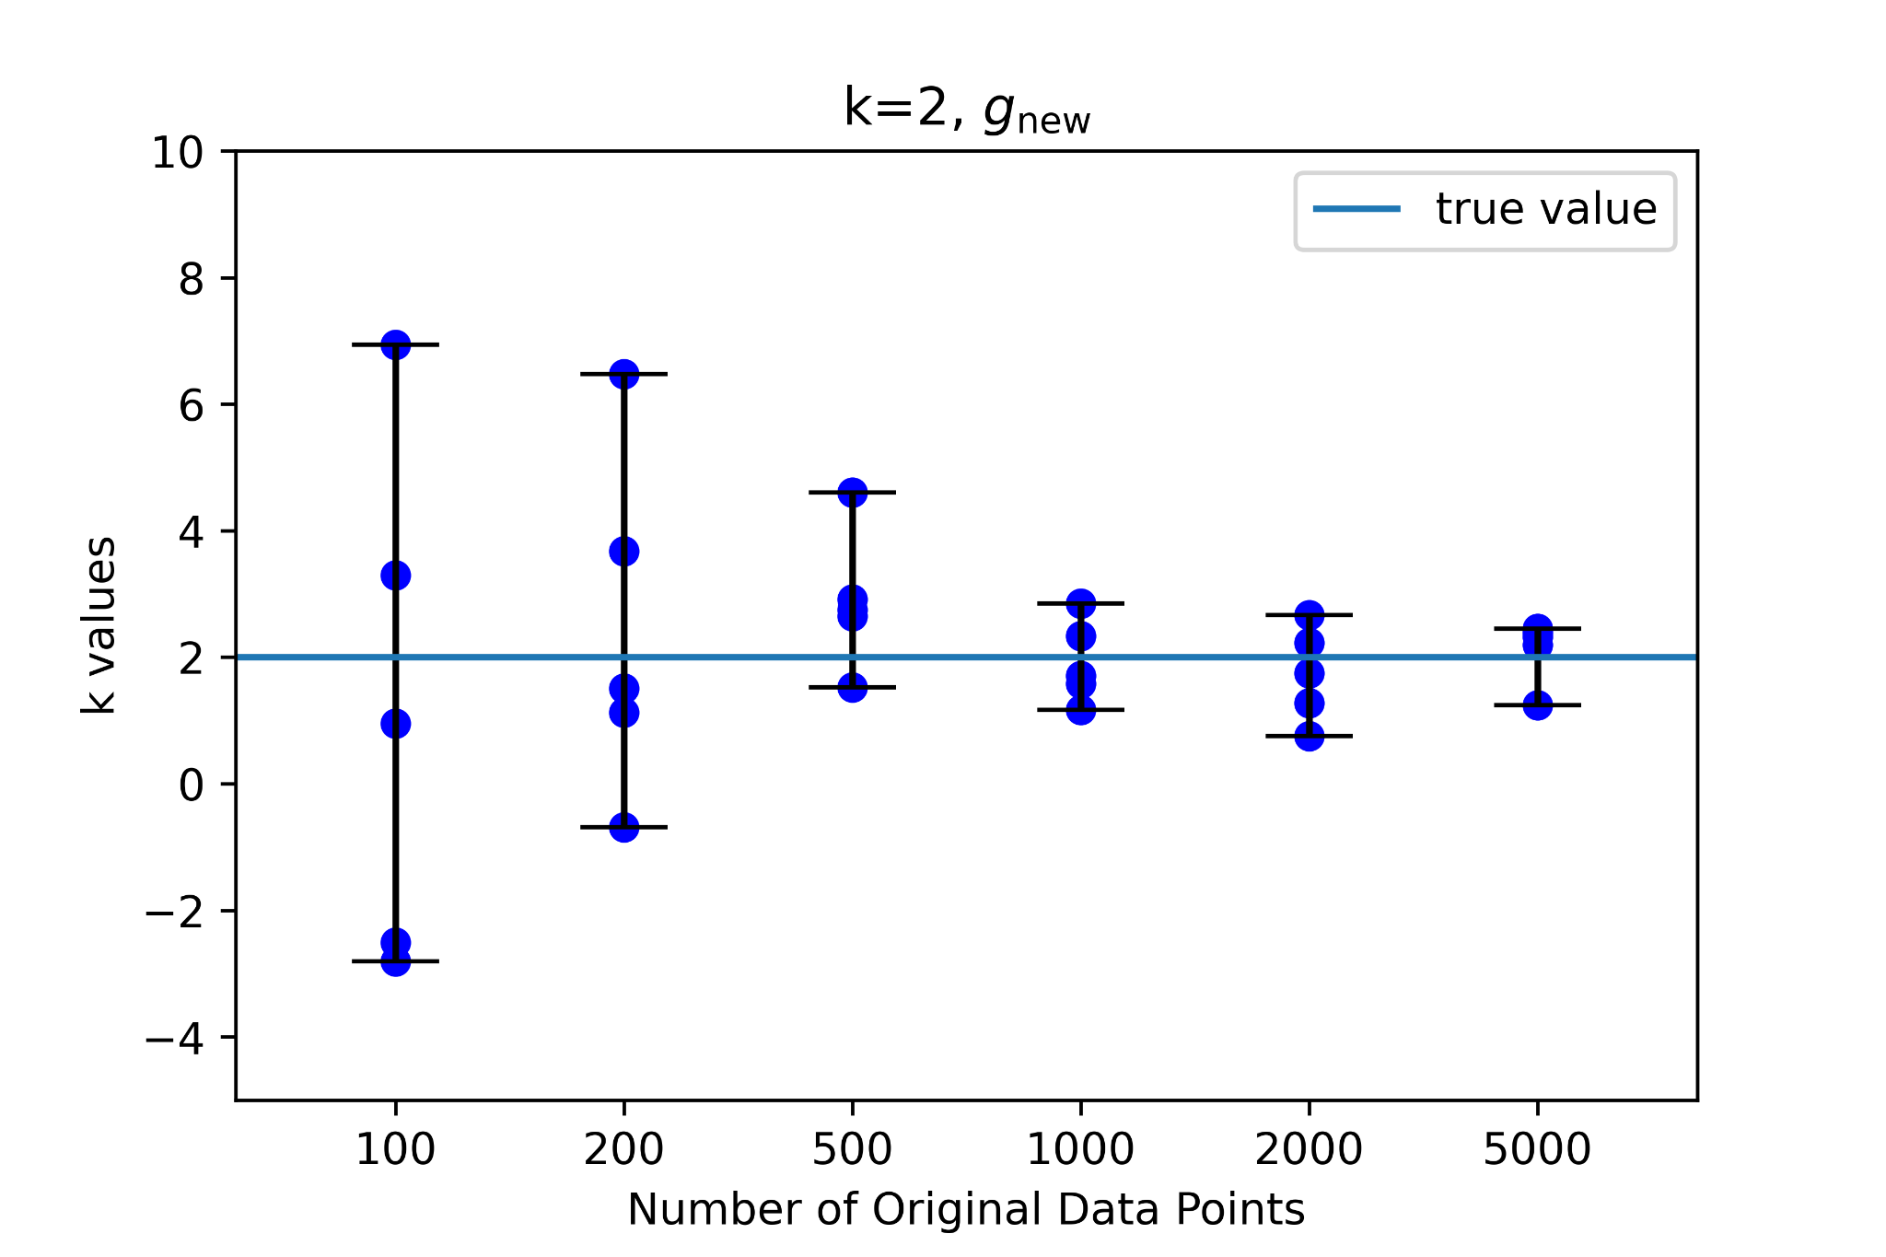

Results of g_{new} versus g_{old}
The following graphs compare g_{new} versus g_{old}, given sample distributions that follow their respective patterns. The overall trends are very similar.

Slide 6
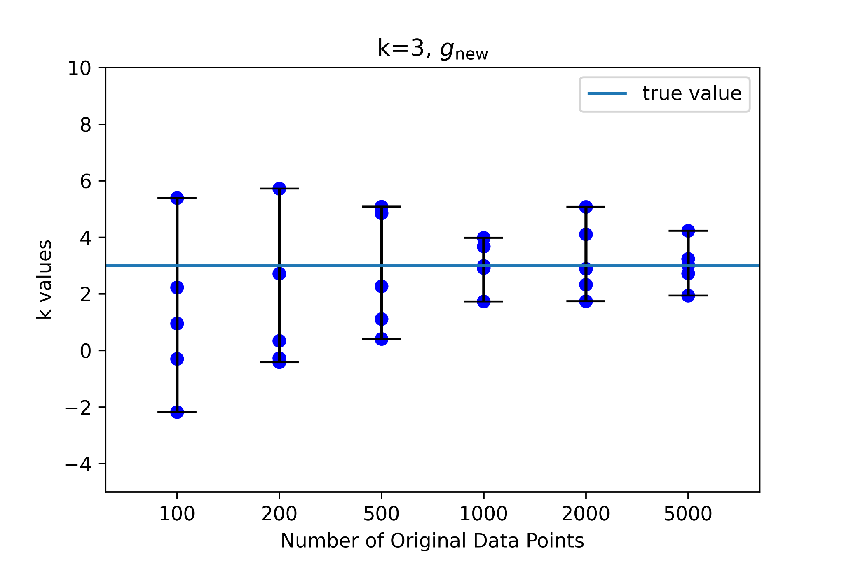
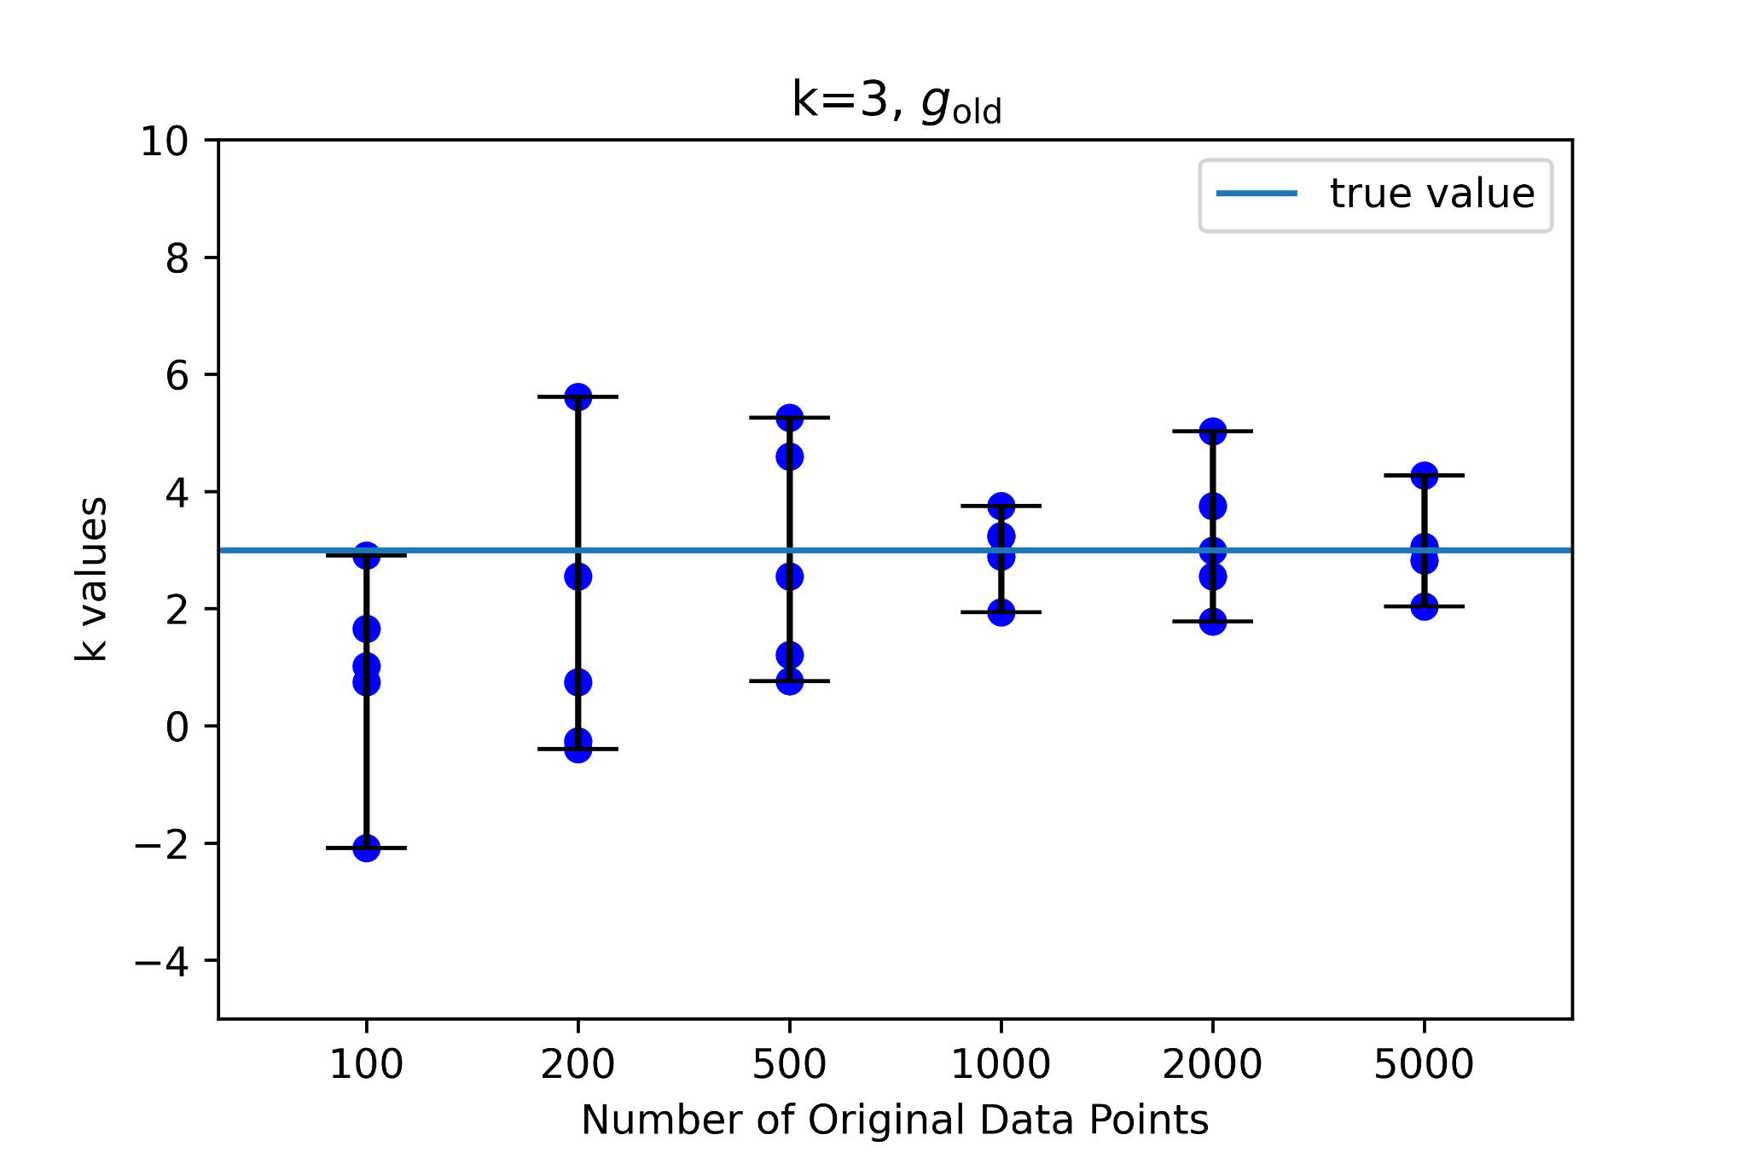
(cont.) k=3
For k=3, there are similar trends.

Slide 7
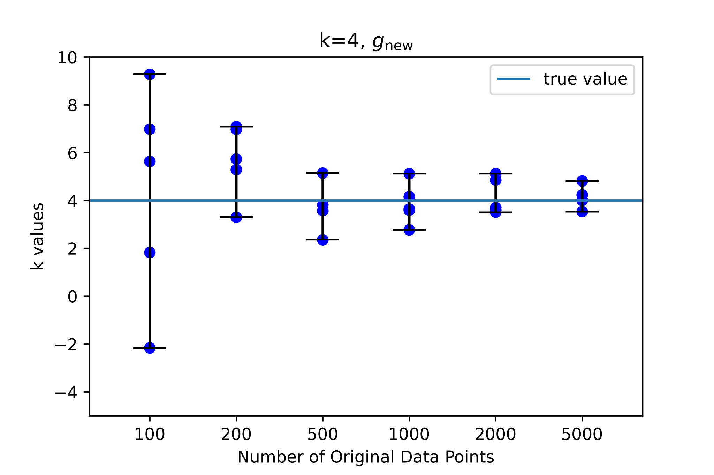
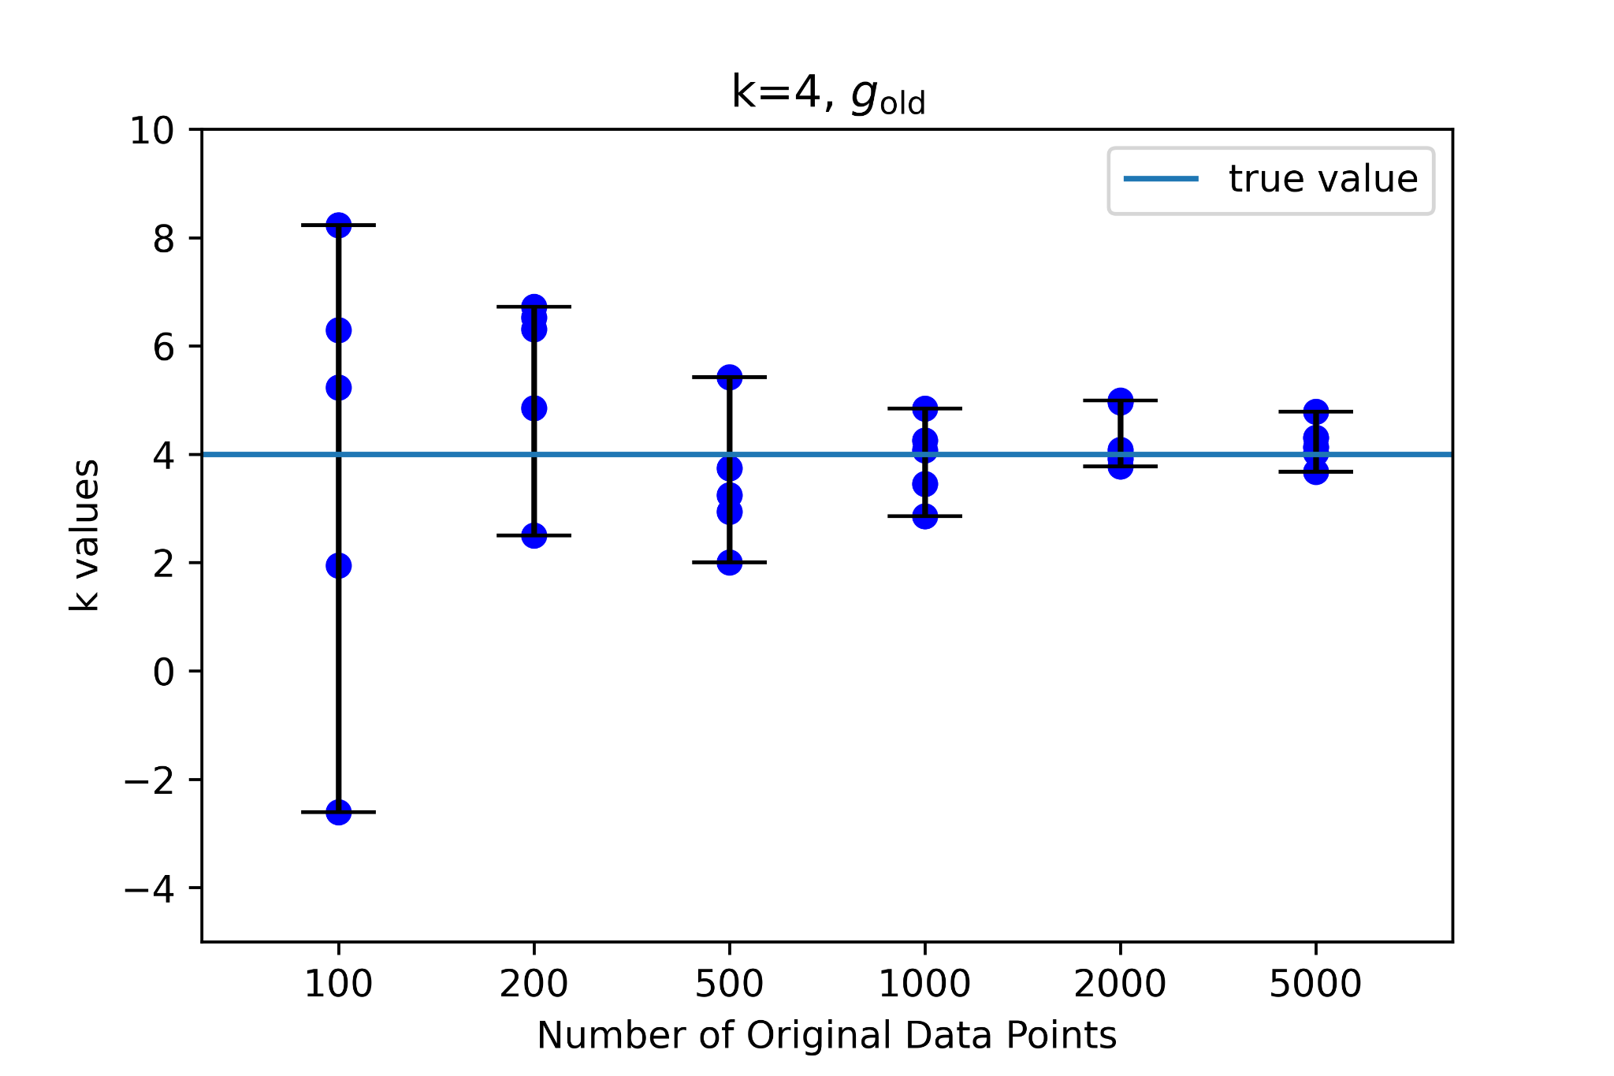
(cont.) k=4
For k=4, there are very similar trends again.

Slide 8
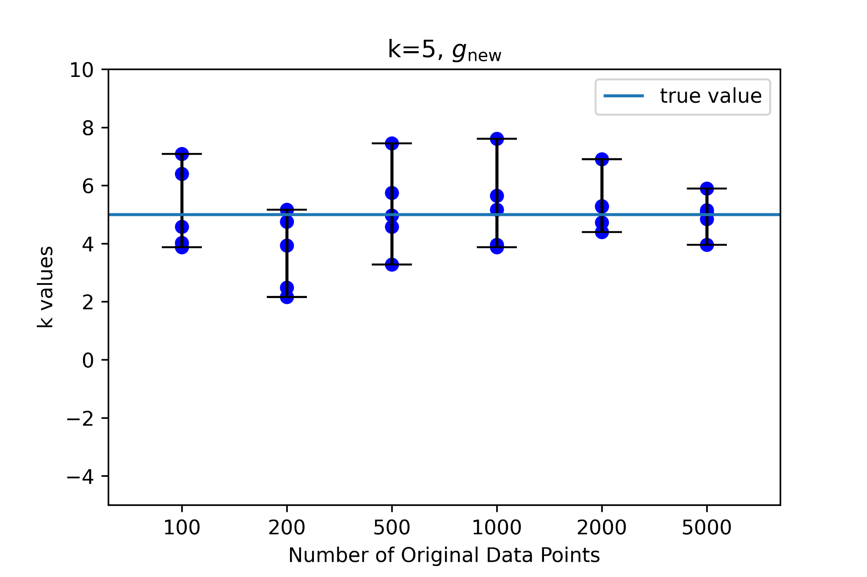
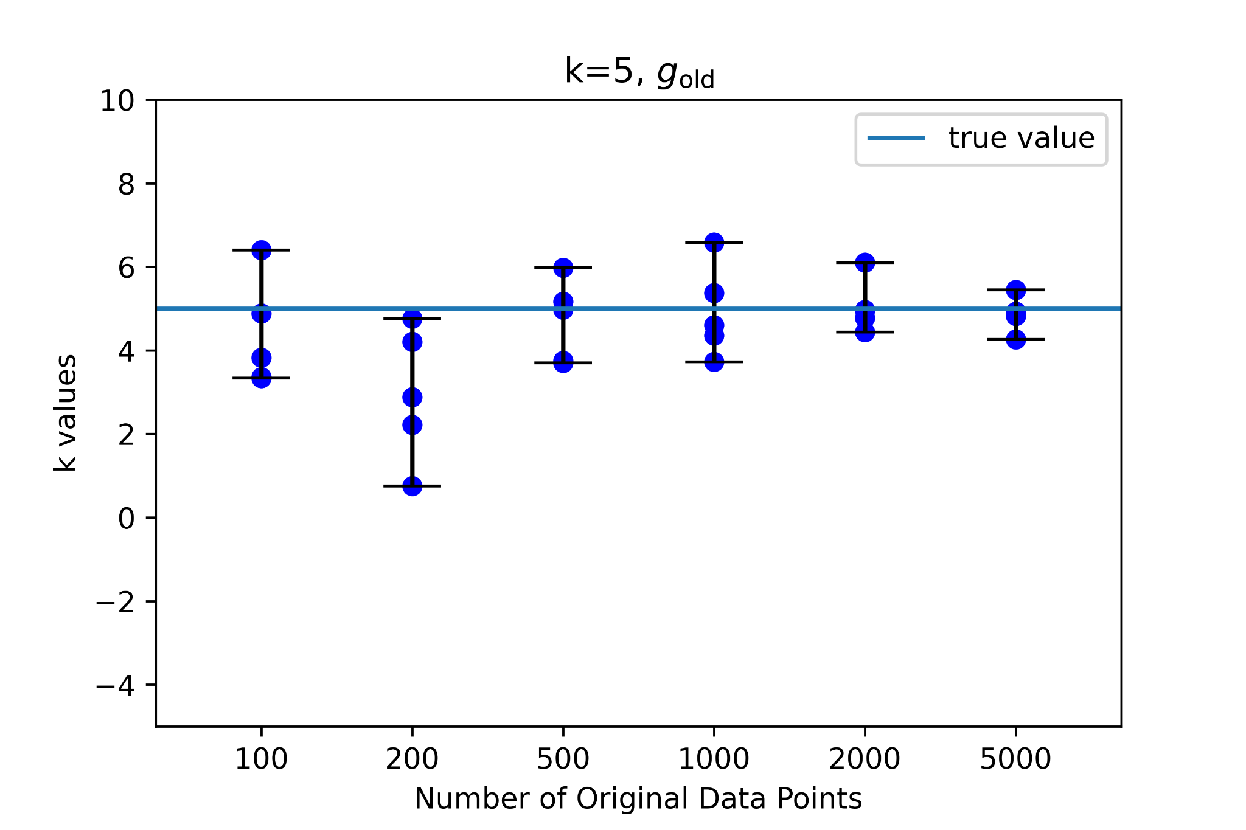
(cont.) k=5
For k=5, the g_{new} has slightly larger ranges in k than g_{old}.

Slide 9
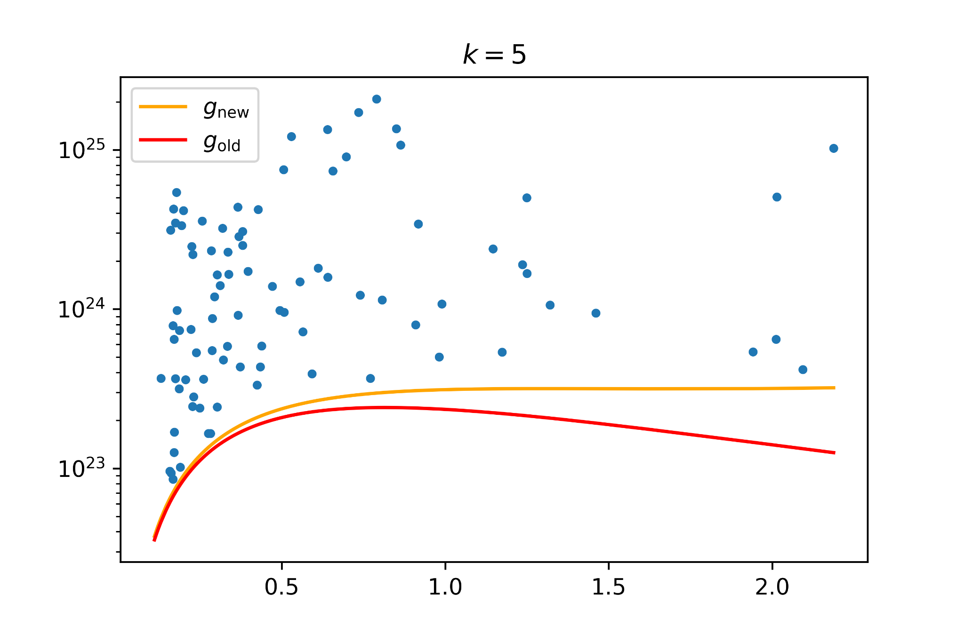
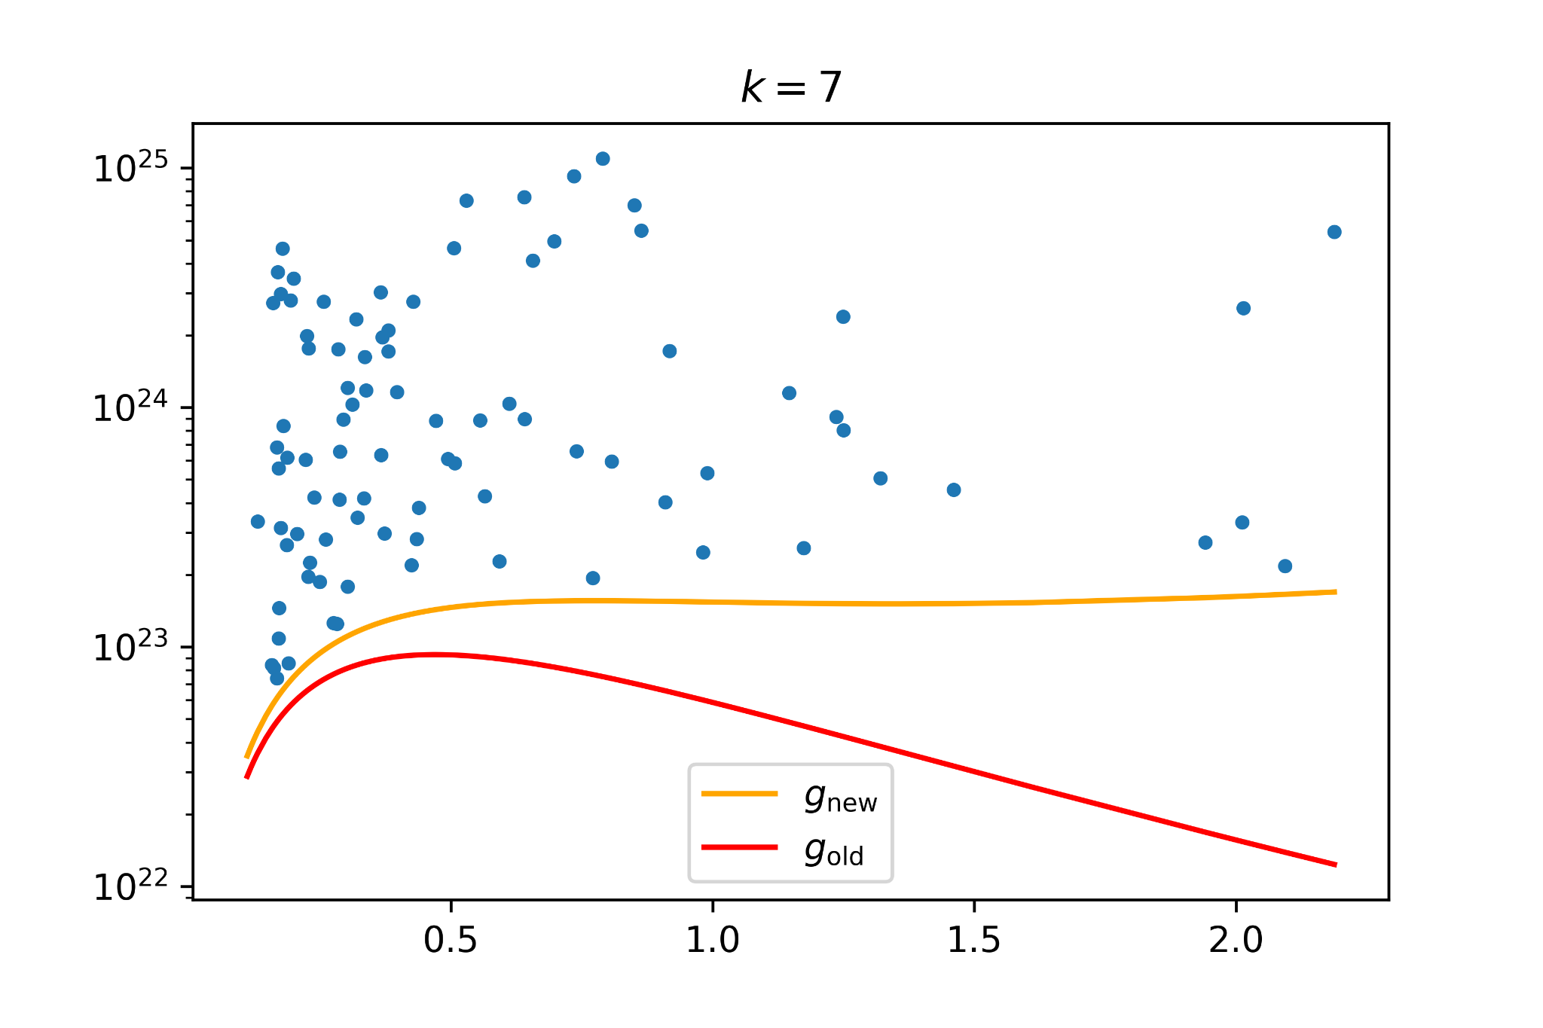
Reason for minimal difference
I believe the reason for minimal difference is because at k=5, the non-monotonicity of g_{old} is not very pronounced yet. See the right.
In order to exaggerate the differences, we can try using Z_{c} = 2.5, and k=7, like the graph on the right.

Slide 10
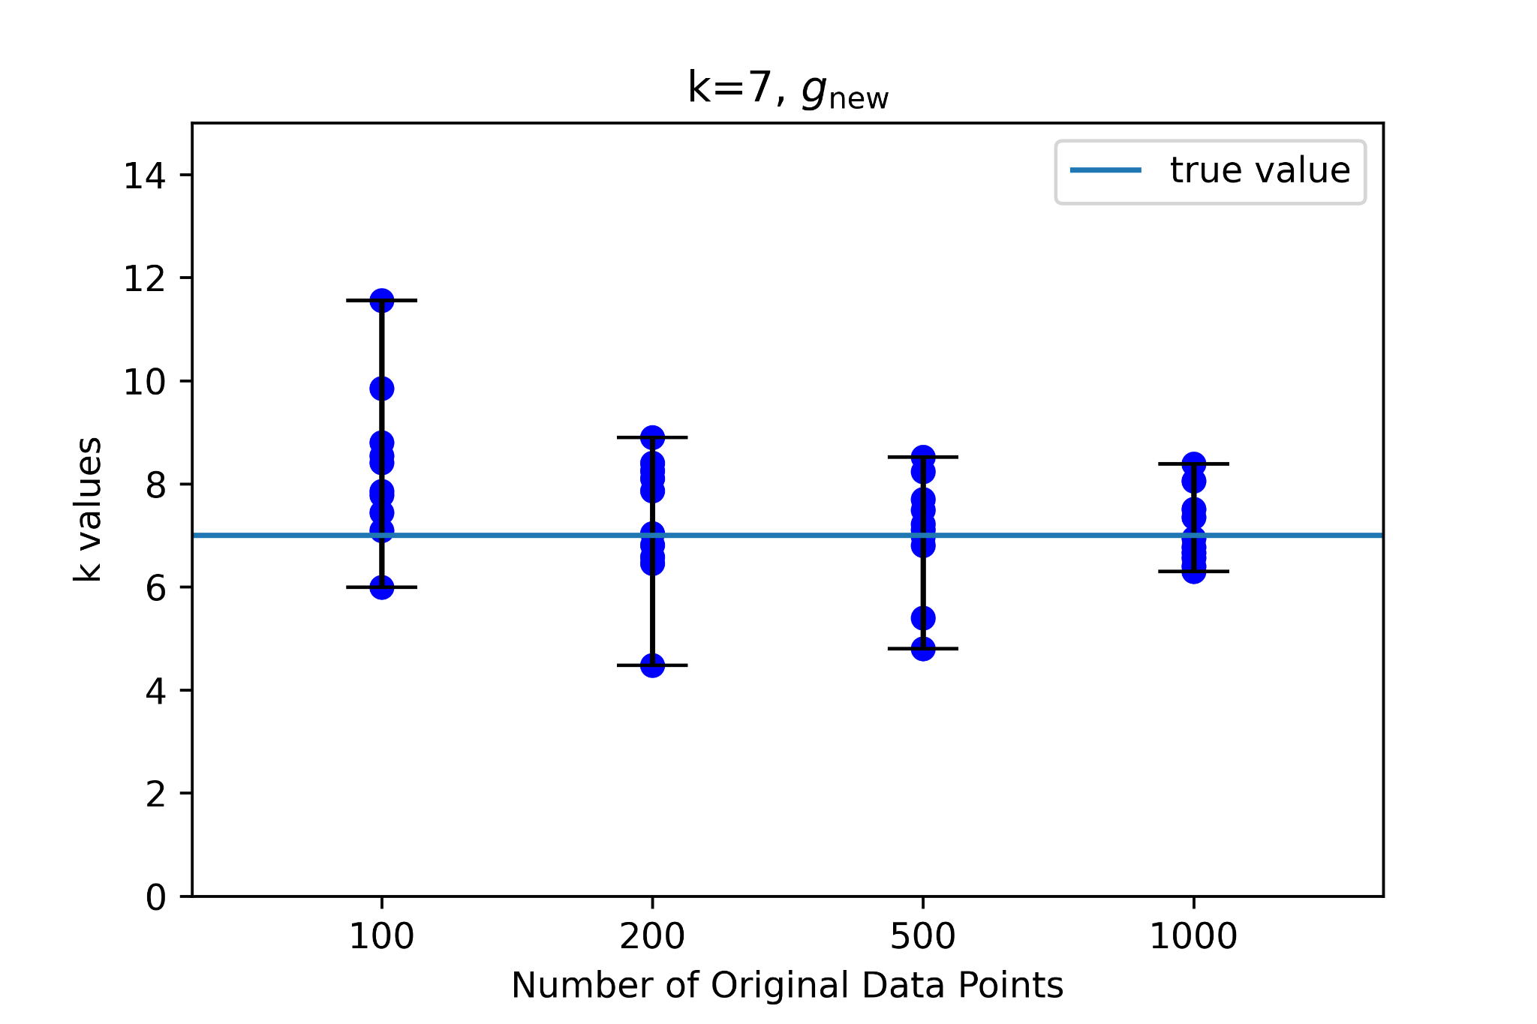
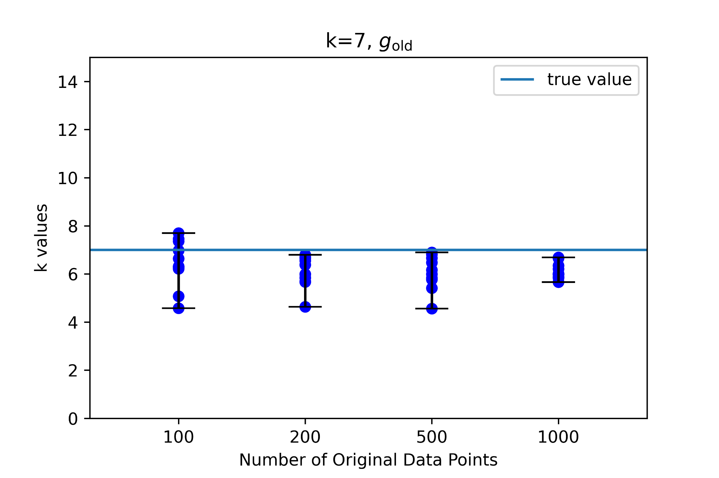
(cont.)
In these two graphs, it is pretty clear that while the average k value using g_{new} is always around 7, the true value, the use of g_{old} results in k values that are consistently lower than 7.

